Slide 1
COMPUTER SCIENCE Fərid Kərimli
Tic Tac Toe: example and tests

Slide 2
Plan
Game Progress
Tests

Slide 3
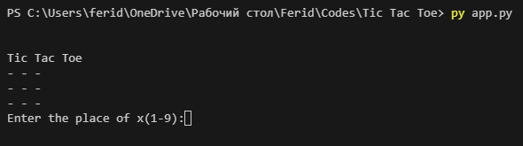


Game Progress
You can see tittle of the game and area.
Enter the numbers with that suitability and x putted selected place also algorithm put ‘O’.

Slide 4
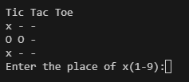
First move is random.
Second move is depend on human's(user) move. If there are two 'x' in a row, column, or horizontal, Bot blok the third one.
Also try to win.

Slide 5



DRAW
Lose
Win

Slide 6
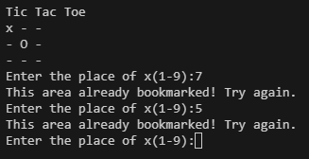
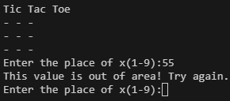
Tests
Don’t worry about write same num and bookmarked number code give you another chance
Also don’t worry about write out of range numbers code give you another chance

Slide 7

Thanks for attention. Wish you stay away from bugs☺

